Slide 1
Answer Set Programming

Slide 2
Answer set programming, or ASP, is a technique based on logic programming that allows us to define a generative space in abstract terms, then iteratively place constraints on that generative space to whittle down the output to what we want.

Slide 3
ASP
Solving computational problems by reducing them to computing answers sets of logic programs is called answer set programming
Useful for problems such as
– Space shuttle and computer configuration
– Solving puzzles and games (e.g., Sudoku)

Slide 4
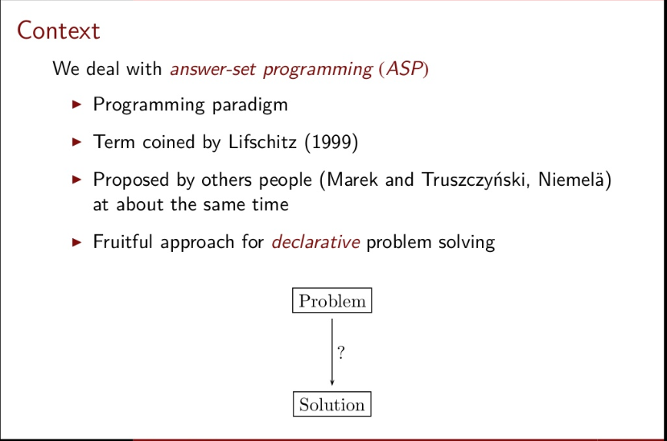

Slide 5
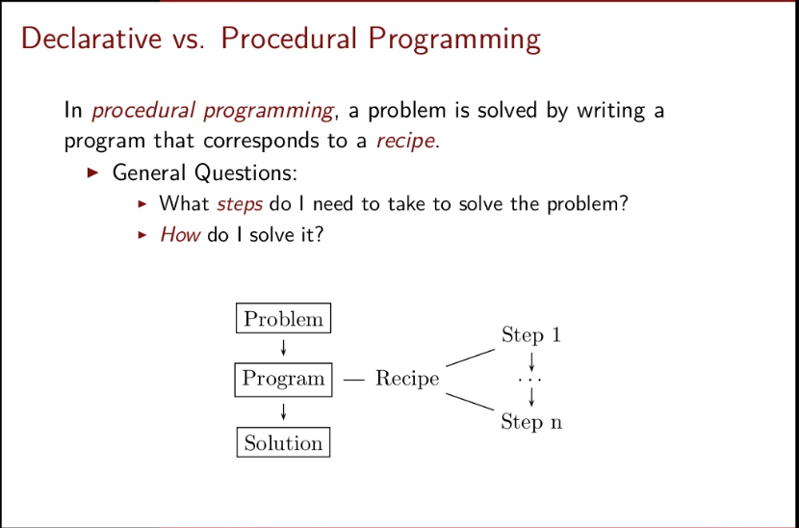

Slide 6
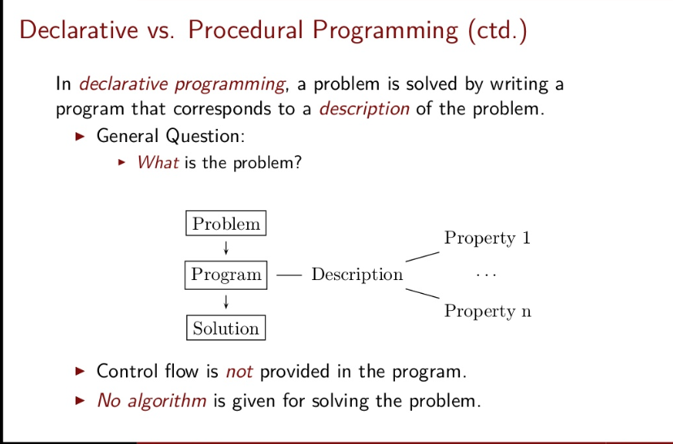

Slide 7
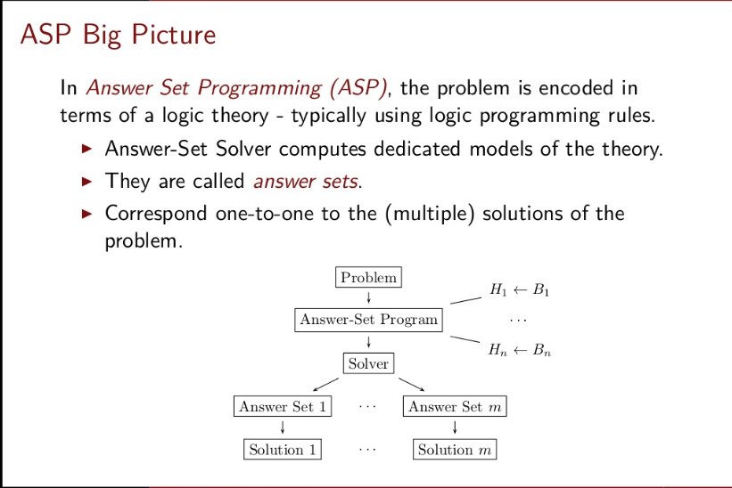

Slide 8
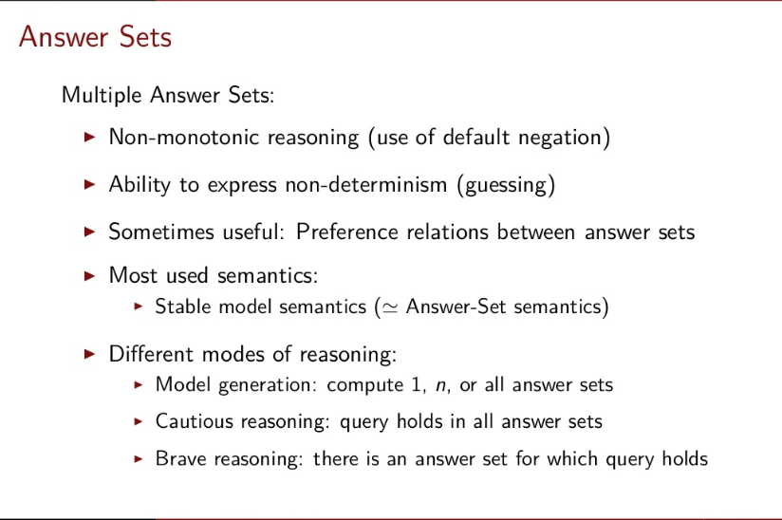

Slide 9
ASP Facts and Rules
The program is defined through relations, or logical propositions.
Example:
p.
q.
q :- p.
This is a rule, or a clause,
In q:-p, q is the head and p is the body.
The symbol :- is referred to as the “neck” of the rule

Slide 10
Answer Sets
Suppose our complete program is:
p.
q :- p.
Unlike in Prolog, this doesn’t need to issue a query in order for computation to happen.
The answer set solver instead produces all possible collections of facts that are consistent with the ones in the program.
After execution, it gives a single answer set:
p q
This set represents all consequences that are derivable from the program.
Can be used this to do neat recursive searching in a very concise way

Slide 11
Example: Edges and Paths
Representation:
node(1). node(2). node(3). node(4). node(5). node(6).
edge(1, 2; 1, 3; 1, 4).
edge(2, 4; 2, 6).
edge(3, 4).
edge(5, 4; 5, 6).

Slide 12
Rules
a rule relates edges to form paths, i.e. a rule schema, ranging over variables for the nodes in question.
Rule 1: paths are reflexive: every node has a path to itself.
path(X, X) :- node(X).
Rule 2: Paths are transitive. (Recursive Rule)
path(Source, Dest) :- edge(Source, Target), path(Target, Dest).

Slide 13
Output of the program Execution
path(1,1) path(2,2) path(3,3) path(4,4) path(5,5) path(6,6)
path(1,2) path(1,3) path(1,4) path(2,4) path(2,6) path(3,4)
path(5,4) path(5,6) path(1,6)

Slide 14
Graph Coloring
Assign a random color to every node in our graph.
Define some colors : color(red). color(green). color(blue).
write a choice rule : {colornode(1, C)}. i.e. choice rule chooses any color for the node 1.
{colornode(1, C) : color(C)}. i.e. C ranges over colors defined in C variable

Slide 15
Program
{colornode(1, red)}.
{colornode(1, green)}.
{colornode(1, blue)}.

Slide 16
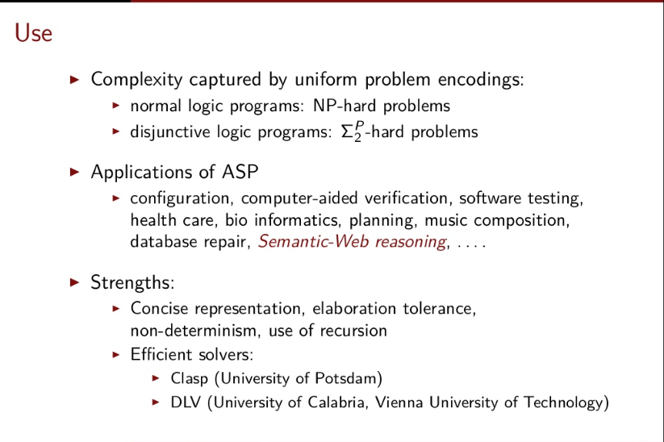
ASP applications

Slide 17
Answer set programming can be seen as an extension of negation as failure or as a refinement of circumscription;
it generates possible values for logical variables, and checks for consistency.

Slide 18
ASP merits and demerits
The advantage of answer set planning over other planners is the degree of flexibility
The planning operators and constraints can be expressed as logic programs and are not bound to the restricted format of a particular planning formalism.
Answer set programming speeds up nonmonotonic Inference.
In answer set programming, solutions to a combinatorial search problem are represented by answer sets.
The disadvantage of answer set planning is the same as for other propositional techniques: if there are very many objects in the universe, then there can be an exponential slow-down.

Slide 19
Compiled from: References
https://www.slideshare.net/net2-project/answerset-programming
http://www.cs.cmu.edu/~cmartens/asp-notes.pdf

